Slide 1
SMART
HELMAT
Guided By : Mrs. Jaseena C. A.
Asst.Professor-Dept. CSE
Reg. Number | Full Name
CEAOECS049 CEAOECS061 CEAOECS065 CEAOECS066 | MUNASAF P. K. RAEES MOHAMMED SAFAR SAJID SAJIHE C. K.

Slide 2
Outline
Introduction
Existing System
Proposed Overview
Requirements
References

Slide 3
Introduction
Increased road accidents
Most of the victims of the accidents are those who travelled in the bike without using helmet
We designed this project to meets the requirements of a bike rider to provide maximum safety

Slide 4
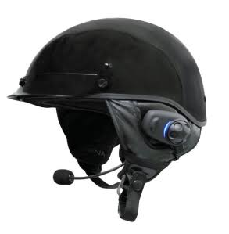
Existing System
Helmat with bluetooth facility
Can pick calls during driving
Expensive
Not available everywhere

Slide 5
Proposed Overview
Objectives

Slide 6
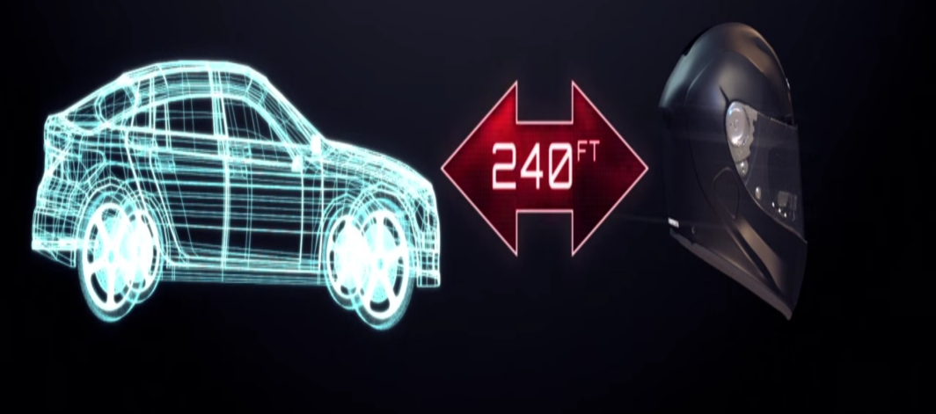
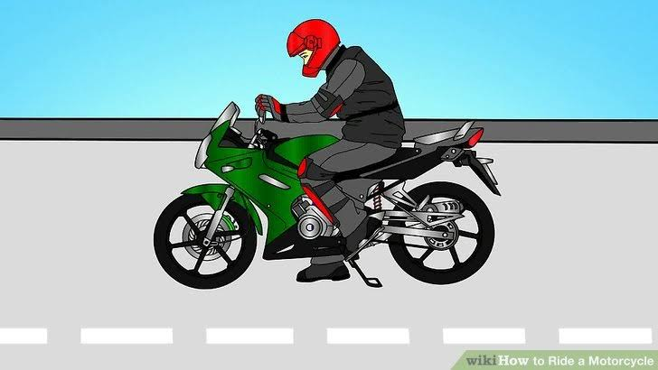
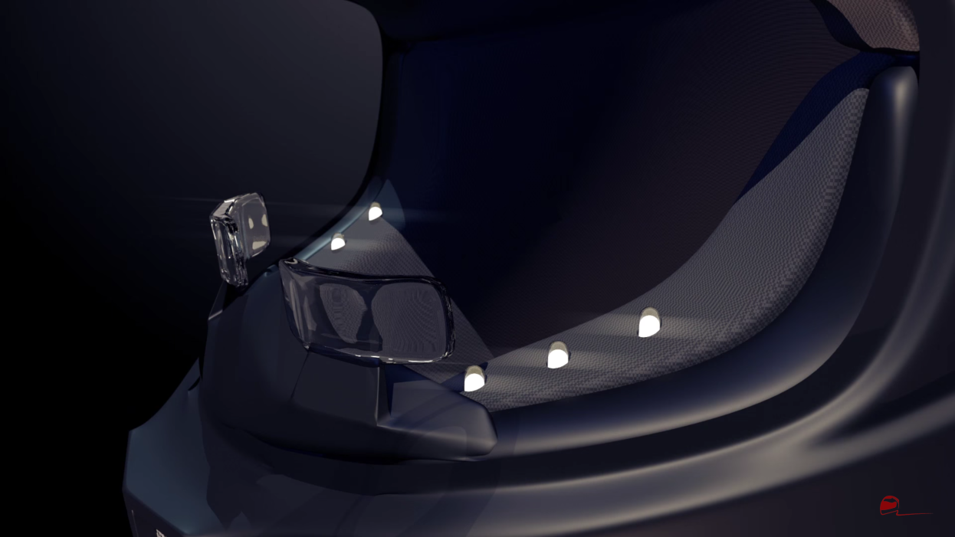
1

Slide 7
2. Communicate with pile rider
3. Bike doesn’t starts until helmet worn
4. Pick calls during ride
5. Hear music
6. Hear navigation sounds
7. Water repellent (nano technology) and day/night glasses

Slide 8
Scope
Increase the safety of a bike rider
Can reduce accidents caused due to carelessness
Can be implemented with less expense

Slide 9
Requirements
Bluetooth device
Day/night glass
Nano technology applied liquid
Android phone
Led lights
Proximity sensor

Slide 10
References
[1] V. Goverdovsky, D. Looney, P. Kidmose, C. Papavassiliou, and D. P. Mandic, ‘‘Co-located multimodal sensing: A next generation solution for wearable health,’’ IEEE Sensors J., vol. 15, no. 1, pp. 138–145, Jan. 2015
[2] W. von Rosenberg, T. Chanwimalueang, V. Goverdovsky, and D. P. Mandic, ‘‘Smart helmet: Monitoring brain, cardiac and respiratory activity,’’ in Proc. IEEE Int. Conf. Eng. Med. Biol. Soc. (EMBC), Aug. 2015, pp. 1829–1832.
[3] Youtube
[4] Wikipedia

Slide 11


